Slide 1


Finding intersection of two surfaces and finding the equation of curves (through numerical or machine learning methods)
BY
KANAD SEN (22M1674)
GUIDED BY: PROF. Shyamprasad Karagadde
DEPARTMENT OF MECHANICAL ENGINEERING , IIT BOMBAY
Me-789

Slide 2
Introduction to the Problem statement
The problem of finding the intersection of two surfaces and the equation of curves is an important and widely studied topic in mathematics and engineering. Below we will discuss some of the important points.
In many applications such as computer-aided design (CAD), architecture, and 3D printing, it is necessary to find the intersection of two or more surfaces to create complex shapes and structures. Thus we need to find mating curves in many of those cases. Such applications are found in aerospace and automotive industry.
Another important area is the field of computer graphics and animations. All the pictures that we see are form of some parametric equation of curved surfaces. In computer graphics, it is often necessary to render complex objects and scenes that cannot be represented by simple geometric shapes. The intersection of surfaces and curves allows for the creation of these complex objects by combining simpler shapes into more intricate forms. The problem of finding the intersection of surfaces and curves is essential for ray tracing, as it allows for the accurate calculation of the path of light through complex objects.
One of the key challenges in computer vision is identifying the boundaries and shapes of objects in images and videos. Finding the intersection of surfaces and curves can help with this task, as it can provide information about the 3D structure of objects and the way they interact with their environment. Recently Meta released a paper which can easily separate boundaries of objects and distinguish them. Such methods are useful in those cases.
In this project I will be tried finding the points of equation of points and have tried to fit an equation to the above mentioned points.

Slide 3


Mathematical formulation
Now to approach the given problem let us consider two equations/ Functions given $F_{1}\left(x\right)$ and $F_{2}\left(x\right)$ . We can approach the problem by equating two equations to $F_{1}\left(x\right)$= $F_{2}\left(x\right)$ and then simplifying the equations to solve for the points and using them for plotting. However, this has major disadvantages:
1. Equating the equations will not necessarily give points of intersection only. This will most likely give a plane containing the points. For this to give the points lying on the intersection curve we have to also ensure these points satisfy $F_{1}\left(x\right)=0$ and $F_{2}\left(x\right)=0$.
2. Another problem is that what should be our initial assumption in this case as input. The search space is of infinite dimension. So it is highly impractical to keep randomly searching points in this case. Also such a method is very computationally expensive.
Since the above method is impractical so I have used a completely different Method to find the points of intersection. For this I have used Steepest gradient descent to evaluate the points which is computationally faster and easy.

Slide 4

Proposed methodology
Since the previous method is not computationally feasible we have used Steepest Gradient descent in the problem formulation. For this I have to define a new function which satisfies the two equations.
Now here I have defined the new function $G\left(x\right)=F_{1}{\left(x\right)}^{2}+F_{2}{\left(x\right)}^{2}$ which is basically a combination of dependent curves${ F}_{1}\left(x\right)$ and $F_{2}\left(x\right)$. Solving this equation only can give us the points required for plotting the intersection. By using steepest descent algorithm we can continue calculation for (x , y, z) updating it iteratively until the value of G(x) reaches a minimum.
The reason for choosing this function is due to the following reasons :
1. The function is smooth and a continuous function.
2. The minimum value of G(x) possible is zero.
3. The function is differentiable. So this, can be used as an activation function in the Neural Network.
4. When G(x) becomes 0 we can ensure that both the curves are automatically satisfied.
In our algorithm we are taking the initial values of (x,y,z) as some initial values and using them to perform steepest descent since it will be computationally faster as the points will lie on either ${ F}_{1}\left(x\right)$ or $F_{2}\left(x\right)$.

Slide 5
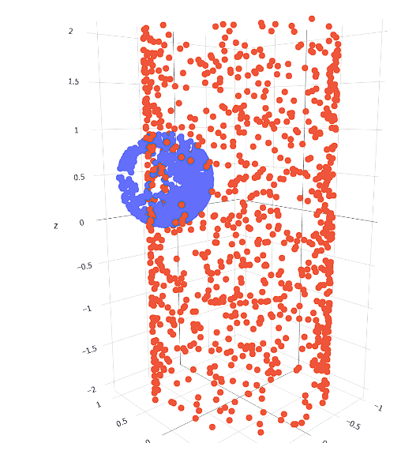
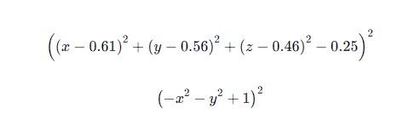
Functions used in our experiment
In the experiment we have used the following curves: Double Cone, Sphere and Cylinder. The above curves have been chosen due to their simplicity and the fact that all these curves are differentiable.
While framing the equations of the curves special care has been taken that these curves intersect somewhere.
The picture shown here represents the intersection points in our experiment.
SAMPLE EQUATIONS

Slide 6
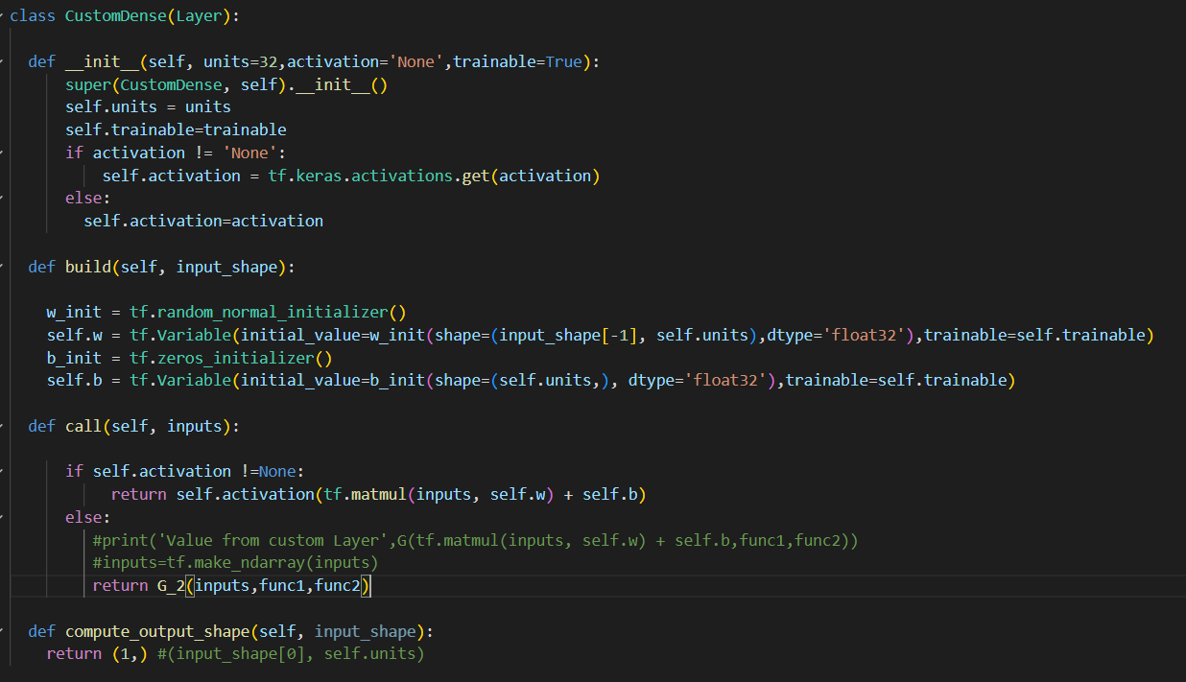
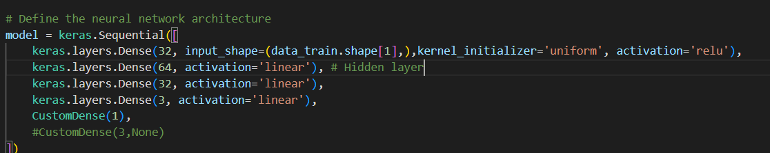
NEURAL NETWORK TO FIND THE X,Y,Z POINTS
To create a Neural network which is faster and can easily give the points (x,y,z) as output we have used the following configurations :
In this case I have designed a custom layer which takes in the inputs and returns the output as an activation function.
Here G(x) is being treated as an activation function.
Only during training is the custom layer present. During prediction I am removing the last layer as I require an output dimension of 3.

Slide 7
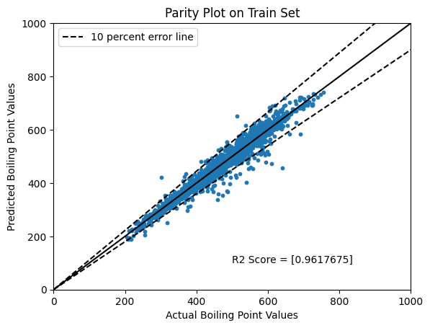
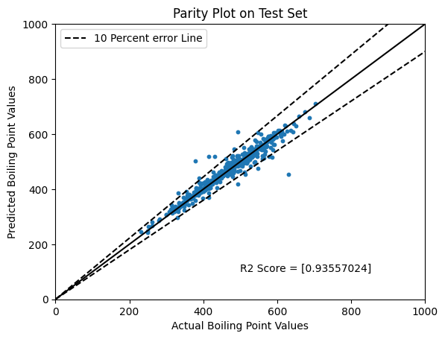
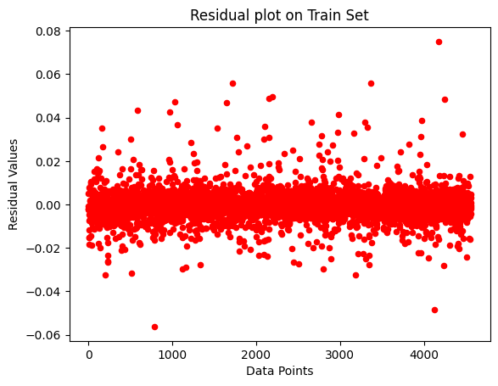
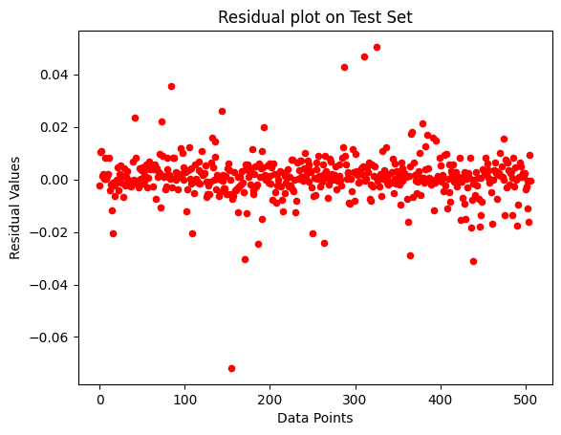
RESULTS
The plots given here show the R2 score on the training set and the test set. As seen we are getting an R2 score of 0.9356 on test set and 0.9618 on the train set. The closeness of R2 values on the train and test set represents that the model is not overfitting the given dataset. A highlight of how our model behaves when compared to actual paper is presented in the conclusion.
From the plots we can see that most of the data points lie in the error range of 10% error line which is within the permissible range.
The residual plots give a uniform distribution which shows that the model made is a proper fit for the graph data.
From both the parity plots we can say that there is a huge presence of outliers which should be removed. However, we have kept them to train the model to train with respect to noise.

Slide 8
CONCLUSION AND INFERENCES
From the previous iteration we have added a new Node feature called Atomic Number. Due to the addition of this feature we have actually seen an increase in R2 score on the test set by 1.68 % from the previous set of features.
The model which has been proposed by us works very well on the test set as seen from the results. We have managed to increase the R2 score on the test set by 10.05 % over single GNN model [2]. Not only that we are also finding an improvement of 3.944 % on the test set as compared to the ensembled model of 40 GNNs. Thus we can say that our model is able to capture most of the variances as seen from the R2 scores.
The R2 score found on the test set is 0.9355 and on that of train set is 0.961 . We see the values of R2 scores of test and train set close enough due to the fact that we have applied a weight_decay of 5e-4 which acts as a L2 regularization parameter.
We have kept the dropout at 0. This is because as we have tuned the dropout percentage we have found out that increase in this percentage reduces the R2 score due to the complexity of information in Graph Neural Networks.
The model provides best performances if the dimension of all the layers is kept at 128 as we have found after tuning the hyperparameters.

Slide 9
FUTURE PLAN
Apply Transfer Learning on the current model and use it solve some another related regression problem like Melting Point using SMILES data to check the validity of the model and if this model is effective on all types of datasets without further or very few training.
Create a webapp using streamlit such that if we give any smiles string as input it will give output of the required property. If time permits we will also allow to give an option for the user to give correct values and allow the model to train on the correct parameter.
We will to try change the batch size, the size of the training set and the test set to check if we can get better results.
Video presentation link
https://drive.google.com/drive/folders/1QG6YiYeRjwq5gI5sVYfnBZ_OzUp-ov2L?usp=sharing

Slide 10
References:
https://en.Wikipedia.Org/wiki/simplified_molecular-input_line-entry_system
https://arxiv.org/abs/2208.04852 Graph neural networks for the prediction of molecular structure-property relationships.
Next generation pure component property estimation models: with and without machine learning techniques
Yann LeCun, Yoshua Bengio, and Georey Hinton. Deep learning. Nature, 521(7553):436{444, 2015.
Shuo Zhang, Yang Liu, and Lei Xie. Molecular mechanics-driven graph neural network with multiplex graph for molecular structures. arXiv preprint arXiv:2011.07457, 2020.
Zonghan Wu, Shirui Pan, Fengwen Chen, Guodong Long, Chengqi Zhang, and Philip S. Yu. A comprehensive survey on graph neural networks. IEEE Transactions on Neural Networks and Learning Systems, 32(1):4{24, 2021.
Greg Landrum. RDKit: Open-source cheminformatics software. accessed on 01.04.2022.
Keyulu Xu, Weihua Hu, Jure Leskovec, and Stefanie Jegelka. How powerful are graph neural networks? ArXiv preprint arXiv:1810.00826v3, 2018.
Kristof T. Schutt, Huziel E. Sauceda, Pieter-Jan Kindermans, Alexandre Tkatchenko, and Klaus-Robert Muller. SchNet - A deep learning architecture for molecules and materials. Journal of Chemical Physics, 48(24):1{11, 2018.
Theoretical Foundations of Graph Neural Networks
https://towardsdatascience.com/introduction-to-message-passing-neural-networks-e670dc103a87
https://paperswithcode.com/method/mpnn
Dynamic Edge-Conditioned Filters in Convolutional Neural Networks on Graphs

